Slide 1
Multi-modal Online Product Similarity Assessment Lou Jiadong Fan Chuxuan Deng Peng
Motivation:
Our project is based on a Kaggle contest called Shopee - Price Match Guarantee
The aim of this task is to match product (according to their images and titles), so that when a customer makes purchase decisions, he can make sure that he gets the product from the cheapest retailer.

Slide 2
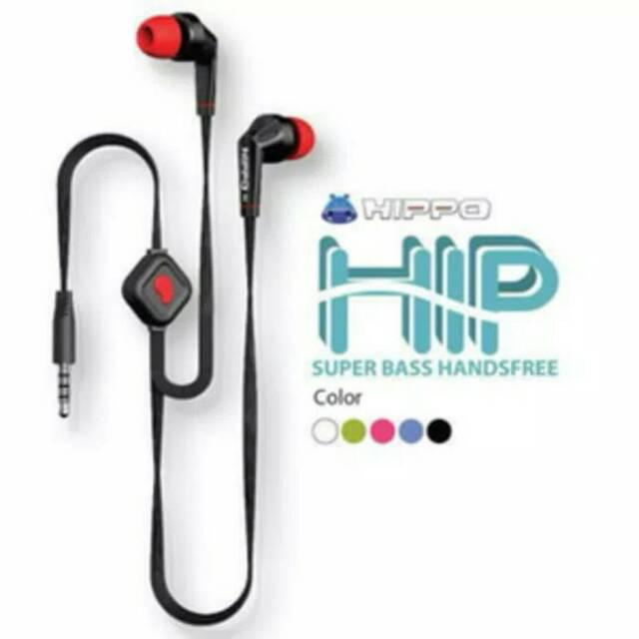
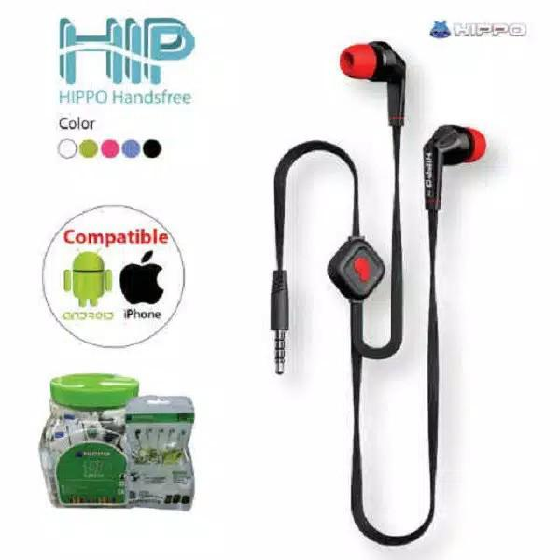
Dataset
32412 training images with corresponding titles and and their matching relationship
Title: [Promo murah ]HEADSET HIPPO HIP / HANDSFRE HIPPO BAS MANTAP / EARPHONE ORIGINAL
Title: Hippo Hansfree Headset HIP SUPER BASS Earphone (Bisa untuk Telp Dan Music) Suport Semua Hp

Slide 3
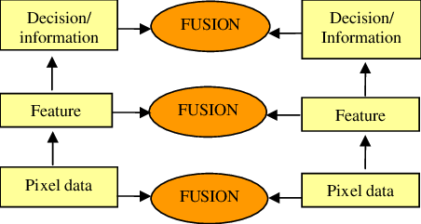
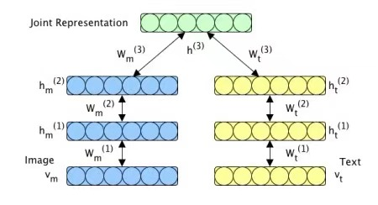
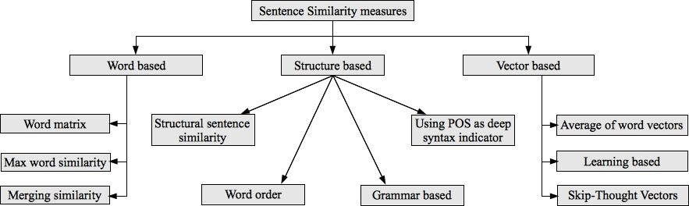
Previous Work & Our Model
Image similarity
Manually-designed features descriptor: SIFT, DAISY, pHash, SSIM etc.
Deep learning: Siamese network and its variation
feature
fusion
Sentence similarity
Multimodal fusion
(feature level)
+
Adjusted Siamese Network
Semantic similarity

Slide 4
Timeline & Expected Result
Timeline
Apr 4 – Apr 11: Paper Review
Apr 11 – Apr 18: Code Review and Study in Kaggle Discussion
Apr 18 – Apr 25: Code Implementation
Apr 26 – May 9: Adjustment and Improvement
May 9 – May 16: Paper Writing
Expected Result
Our model is assessed by F1-Score.
With the multimodal model, we expect he features from images and titles can complement each other and then to achieve a well performance.

